Slide 1


PHILIPPINE TRADITIONAL DANCES
PRESENTED BY:
JACELYN CARATAO
Justine Peralta
Mike Caram
Garvy Capalac
Martin Monte
LAURENZ LISTANGCO

Slide 2
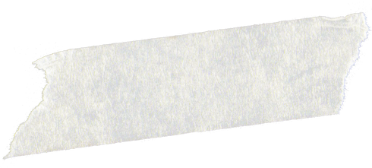



WHAT IS A FOLK DANCE?

Slide 3
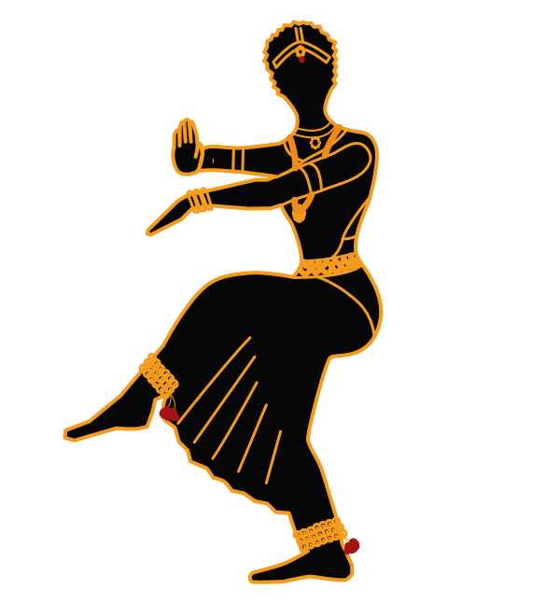


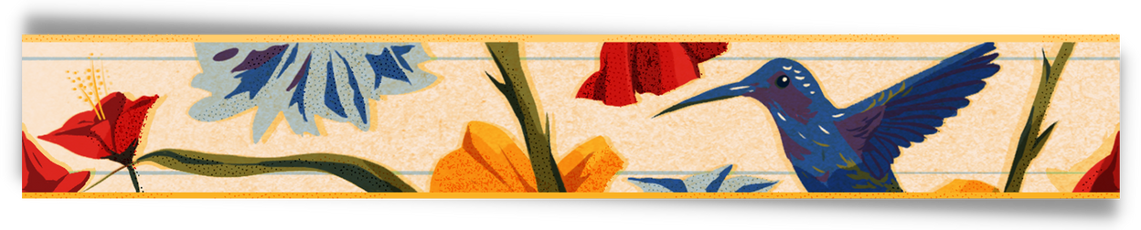
FOLK DANCE
folk dance, generally, a type of dance that is a vernacular,
usually recreational, expression of a past or present culture.
The term folk dance was accepted until the mid-20th century

Slide 4

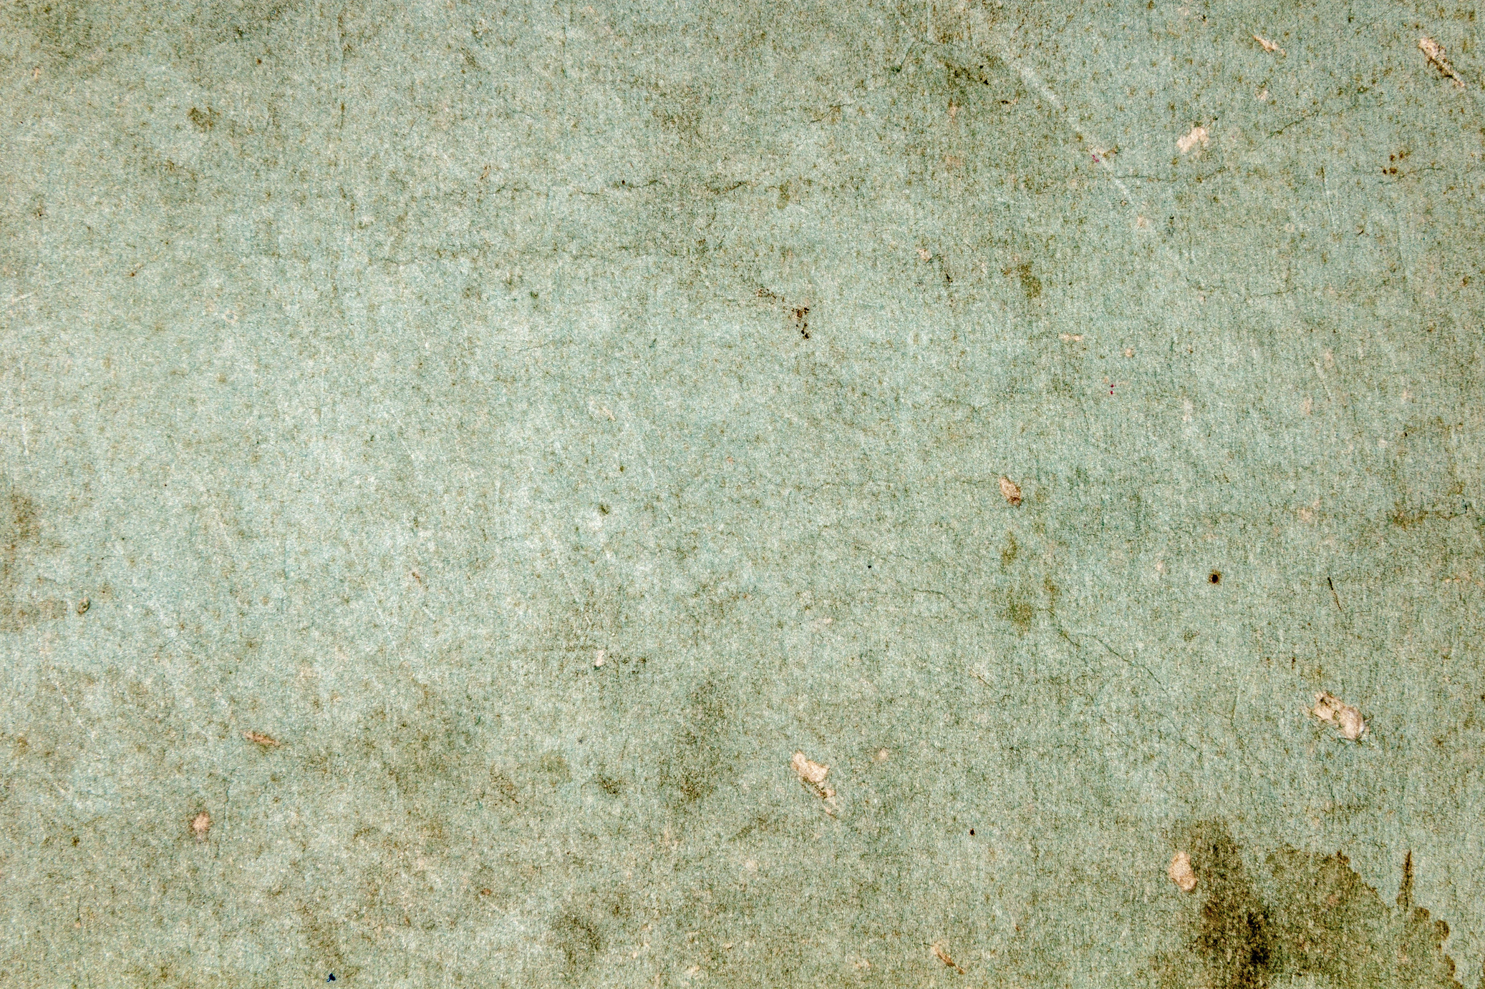

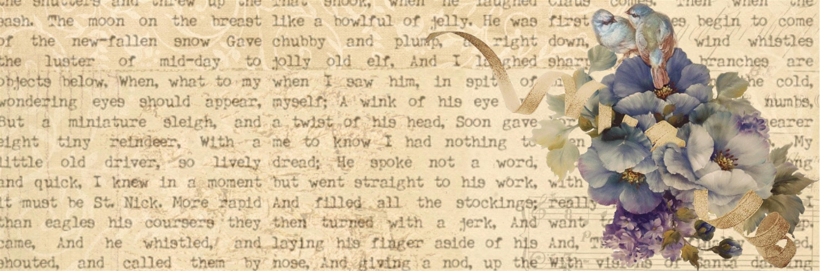
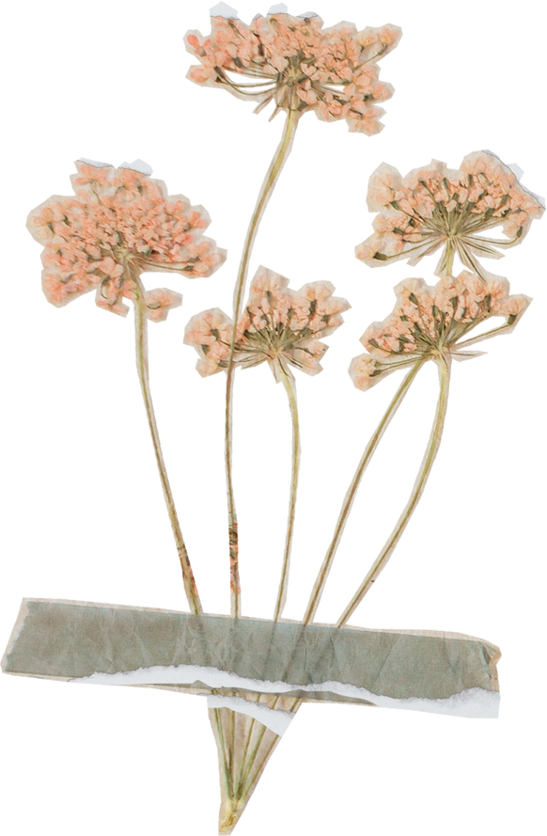
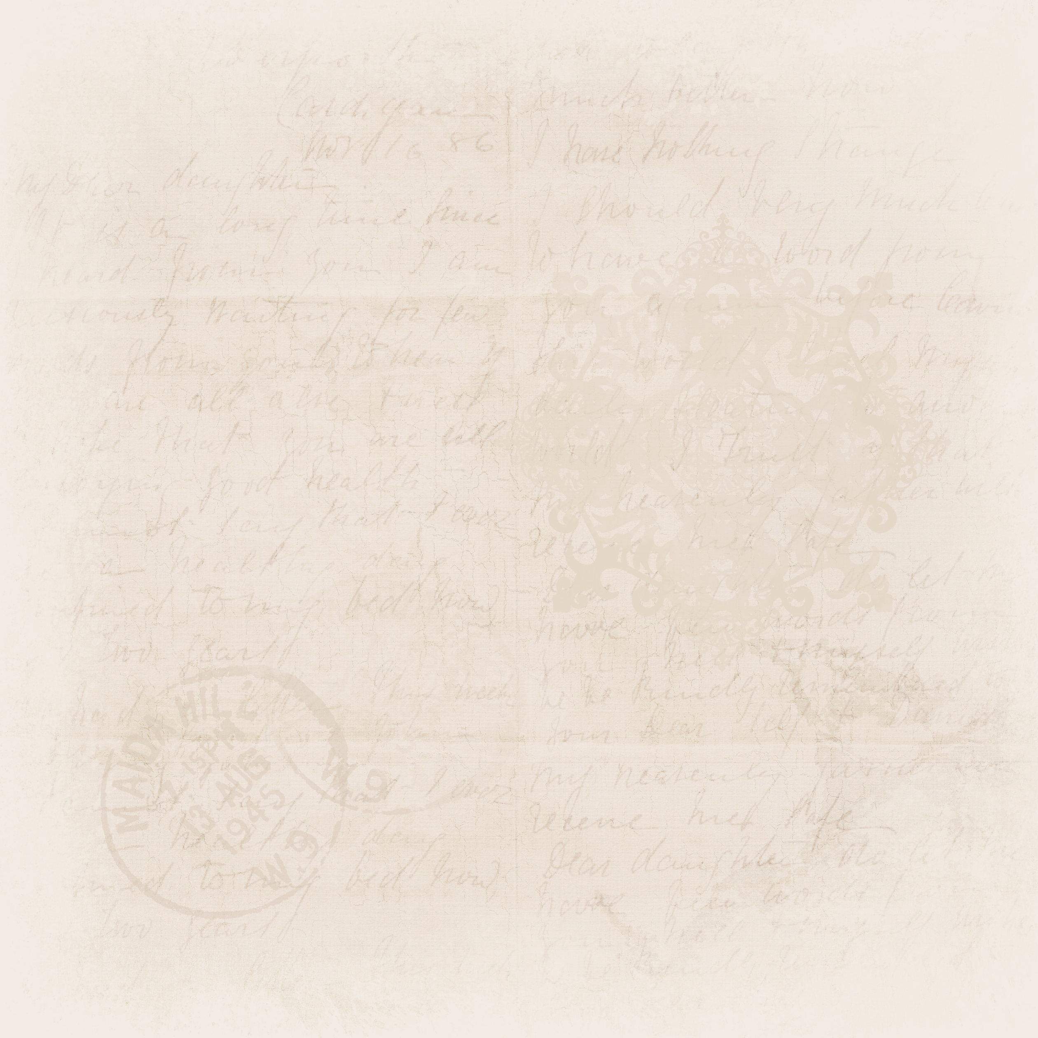

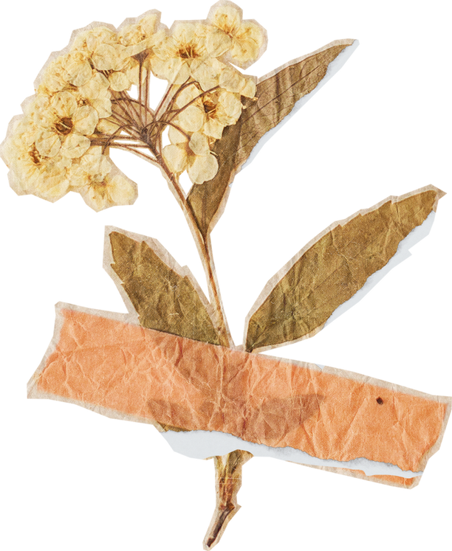
Talking about
Folk Dance (1)
Folk. n. meaning 'people' generally like a group or community. It is originating or traditional with the common people of a country or region and typically reflecting their lifestyle.
Folk Dance. Indicates a certain kind of dance, style or feature when it is distinguished from one's culture or another; they are typically performed as a form of ritualistic entertainment, tell the culture's story, or to assert a cultural pride.

Slide 5

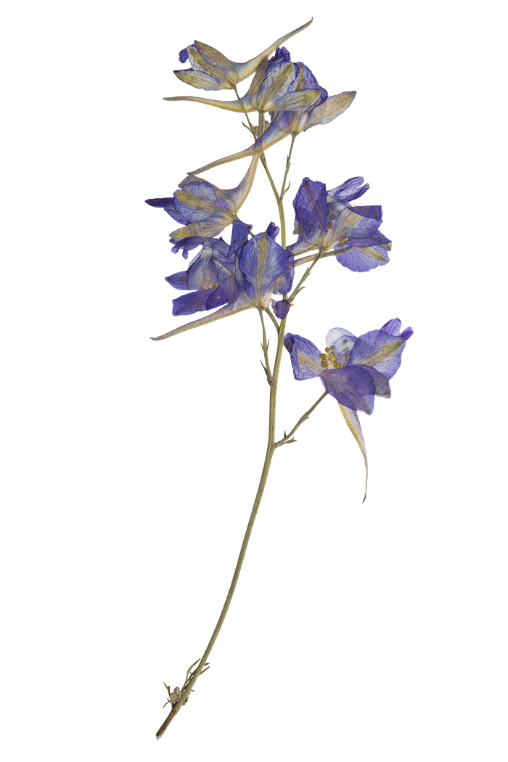




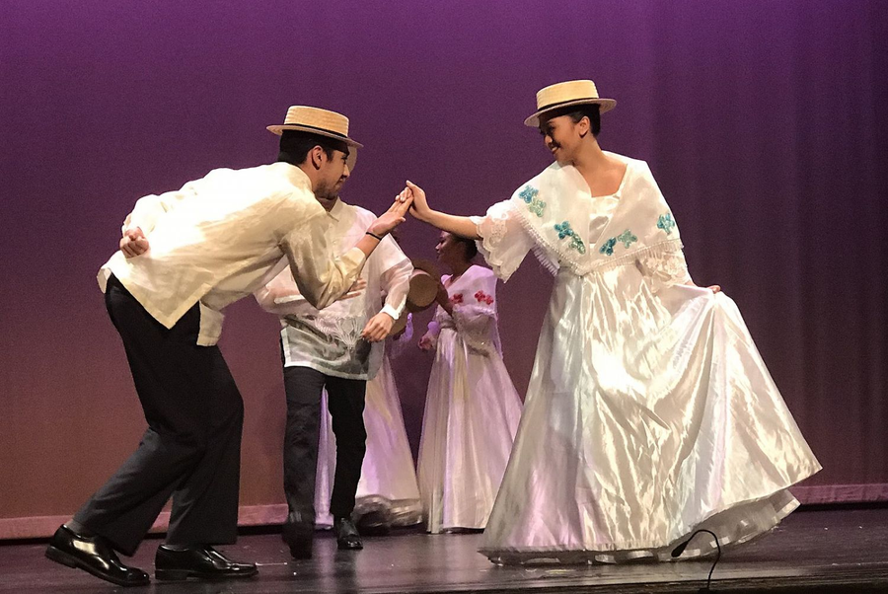

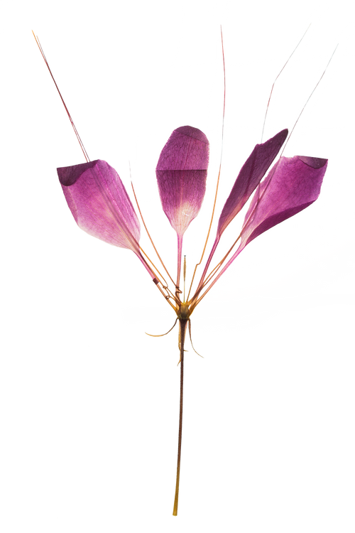
Talking about
Folk Dance (2)
Folk Literature such as Folk Dance, features not only the culture itself but also how it reflects the life of the community of a country or region, since folk dances emphasize the tradition on how the dances showcase the region or community, bounded by their origins, on how these dances have originated based on their experiences, inheritances or innovations.

Slide 6


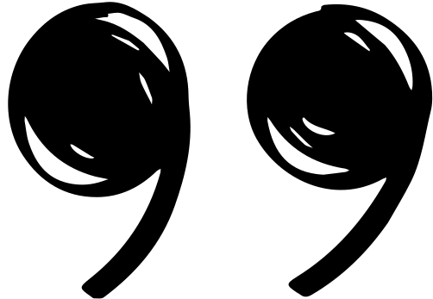
Furthermore....
Folk dances came about as a form of recreational community involvement,
a way to bring people together, celebrate, and have fun as a group

Slide 7
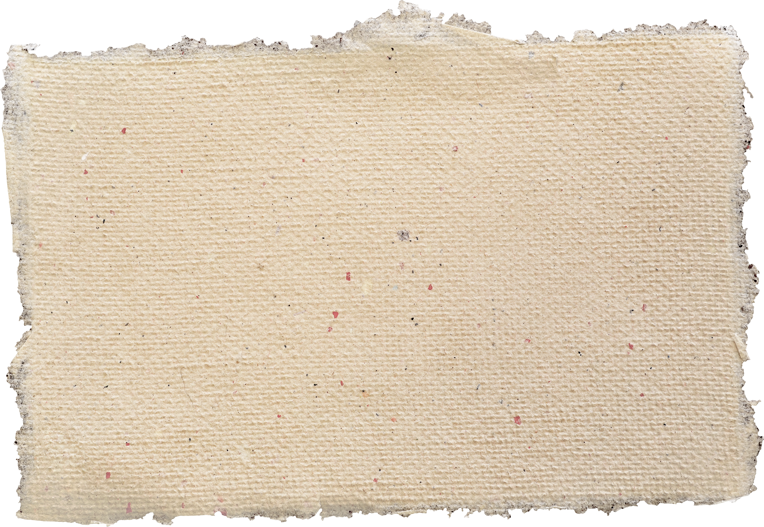
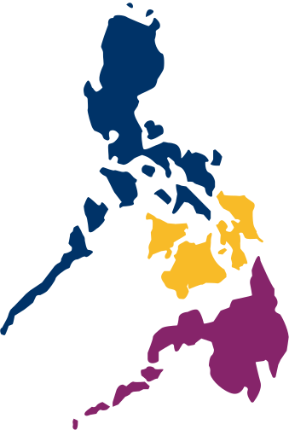
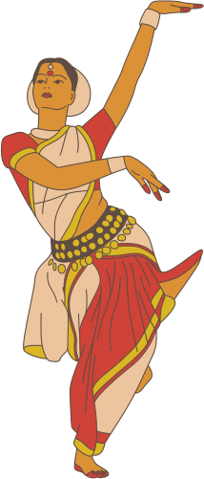
CLASSIFICATION OF DANCES IN THE PHILIPPINES ACCORDING TO TRADITIONAL GROUPS
The Philippines is known for its rich and diverse cultural heritage, which is reflected in its traditional dances. These dances are often categorized based on the cultural groups or regions from which they originate. Here are some examples of traditional dance classifications in the Philippines according to different cultural or ethnic groups:

Slide 8
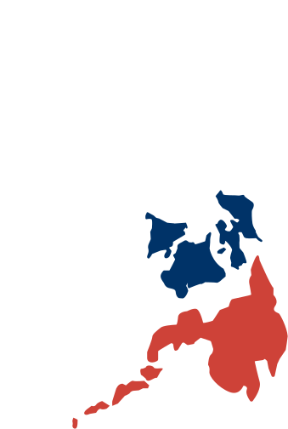
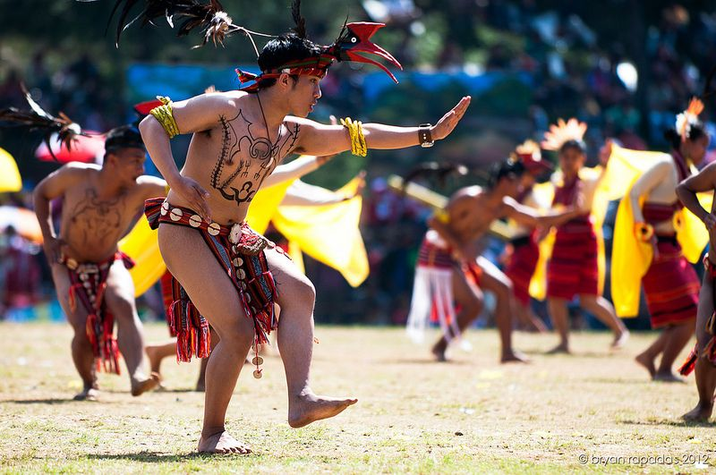
LUZON REGION:
IGOROT DANCES: These dances are performed by the Igorot people of the Cordillera region. They often depict hunting, farming, and other aspects of their daily life. Examples include the Banga (pot) dance and Bendiyan (bamboo dance).

Slide 9


Banga

Slide 10
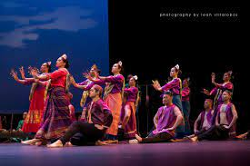
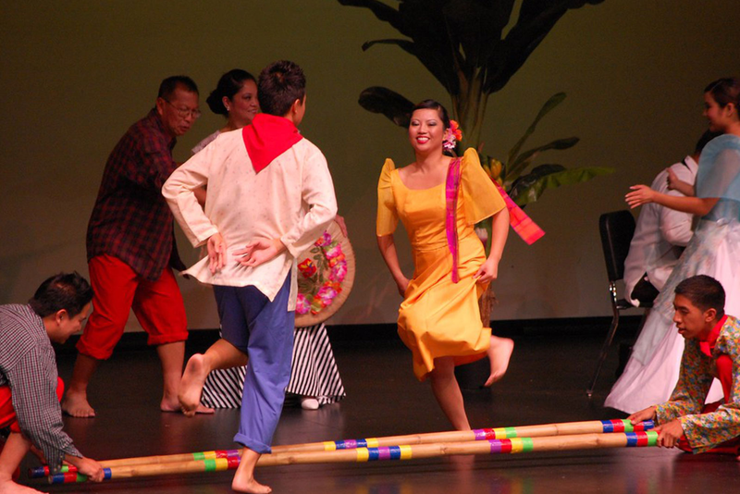
LUZON REGION:
Pangalay: Originating from the Sulu Archipelago, this dance is characterized by graceful hand and arm movements, usually performed by the Tausug and Samal peoples.
Tinikling: A popular dance that involves dancers skillfully stepping over and between bamboo poles as they are rhythmically tapped together.

Slide 11
Pangalay

Slide 12
Tinikling

Slide 13
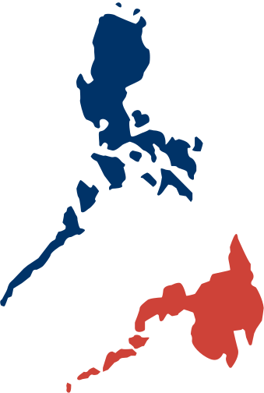
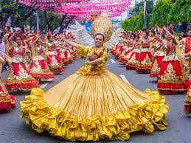
VISAYAS REGION:
Sinulog: A dance in honor of the Santo Niño (Child Jesus) that originated in Cebu. It involves forward and backward steps to the beat of drums.

Slide 14
Sinulog

Slide 15
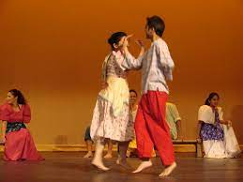
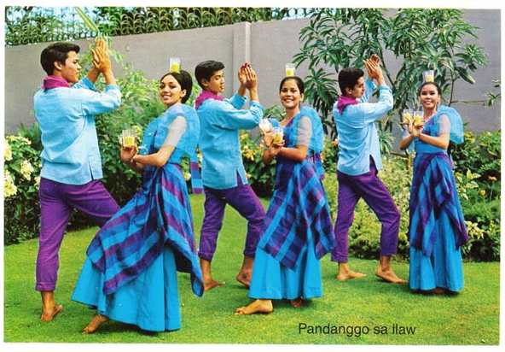
VISAYAS REGION:
Kuratsa: A courtship dance popular in the Visayan islands, characterized by flirtatious movements and lively music.
Pandanggo sa Ilaw: Dancers balance three lighted oil lamps—one on the head and one on each hand—while executing graceful movements.

Slide 16
Kuratsa

Slide 17
Pandanggo sa Ilaw

Slide 18
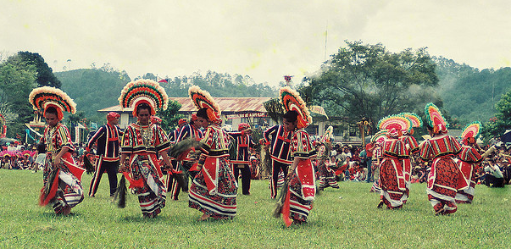
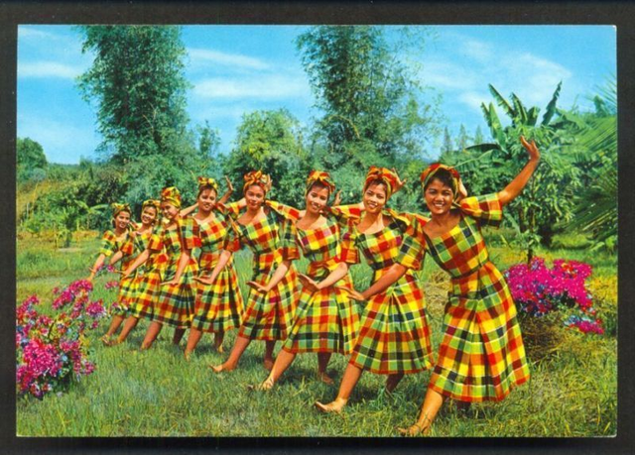
MINDANAO REGION
Dugso: a ceremonial dance among the Manobo people in Bukidnon, Agusan and Misamis Oriental, and usually performed during important occasions.
Itik-Itik: a mimetic folk dance that mimics the movement of ducks. It originated in Cantilian, Surigao del Sur

Slide 19
Dugso

Slide 20
Itik-Itik

Slide 21
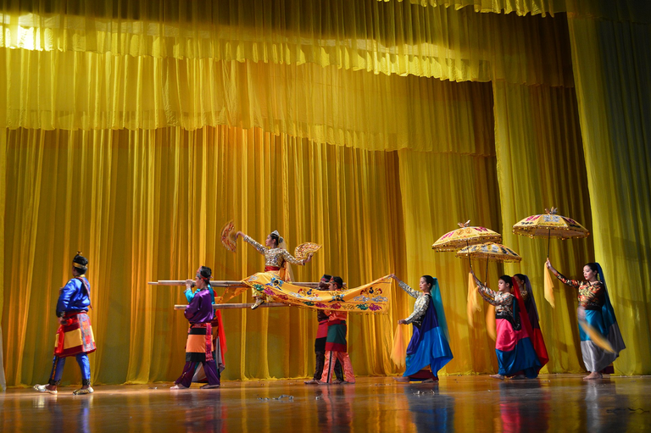
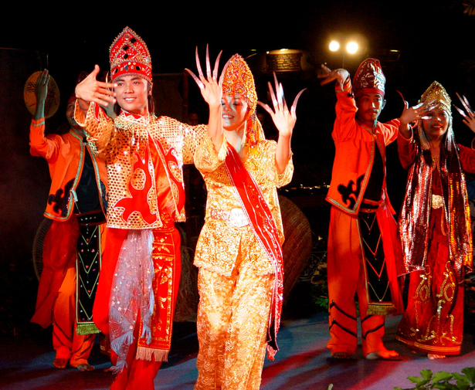
MINDANAO REGION
Singkil: Also known as the Princess Dance or the Royal Maranao Fan Dance, the dance is based on the Maranao interpretation of the ancient Indian epic, the Ramayana: the Darangen.
Kandingan: Performed at Tausog weddings in Jolo, the Kandingan consists of figures and steps based on classical and traditional Indian dance forms.

Slide 22
Singkil

Slide 23
Kandingan

Slide 24

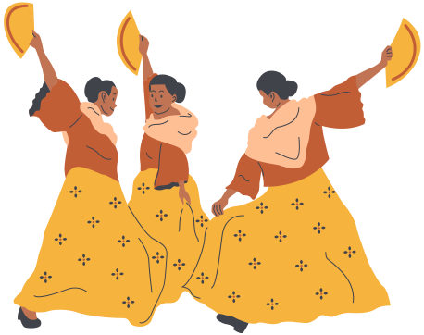
Philippine Traditional Dances
Classification of Philippine Folk Dance According to Nature of the Dance

Slide 25

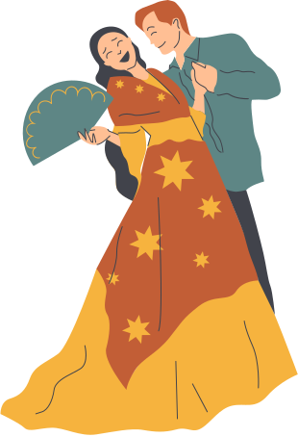
Occupational Dance
Occupational dance is a form of art that expresses the hardworking value of Filipinos
from different places in the country by showing their local culture and livelihood.
01
The theme of the folk dance would differ depending on where they live - near the seas, in
the fields, by the mountains, etc.
02
Occupational dances are those that depict the actions of a particular occupation.
03

Slide 26
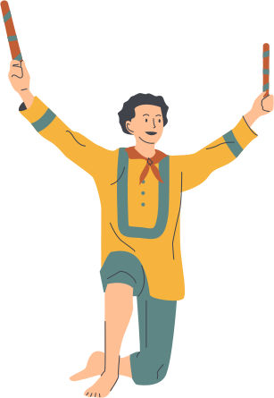
Occupational Dance
Binatbatan
The Binatbatan dance is an occupational dance from Paoay, Ilocos Norte. It depicts the beating of cotton pods to separate the seeds drom the fibers. Weavers in Paoay often engage themselves in abel-making contests. Dancers maneuver in and out of parallel batbat sticks, each about 18 inches long. Th rhythm and speed of the beating of the sticks make for a lively and colorful display.

Slide 27
Binatbatan

Slide 28
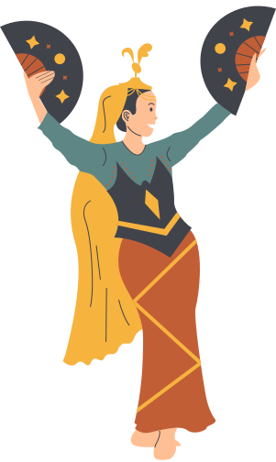
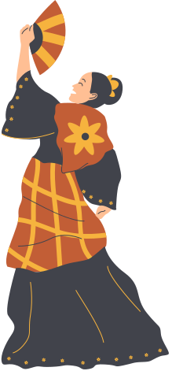
Religous/Ceremonial Dances
Ceremonial dance is a major category or classification of dance forms or dance styles, where the purpose is ceremonial or ritualistic.
Religous/Ceremonial Dances are those associated with religion, vows and ceremonies.
01
03
02
It is related to and overlaps with sacred dance and ecstatic dance.

Slide 29
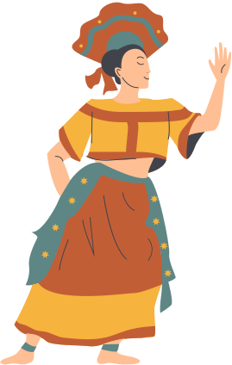
Religous/Ceremonial Dances
Dugso
Dugso is a dance which originated from Bukidnon in Northeast Mindanao. Dancers perform this as an entertainment for the dieties, to make them feel more comfortable during the fiesta that wwas organized for them. It was originally thought that this dance was performed only during harvest time or upon the birth of a male heir. Women would wear colorful feathered head dresses, plaid costumes, and anklets.

Slide 30
Dugso

Slide 31
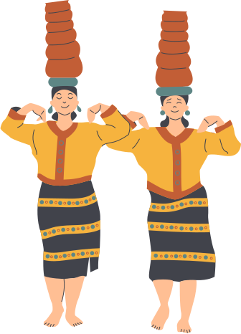

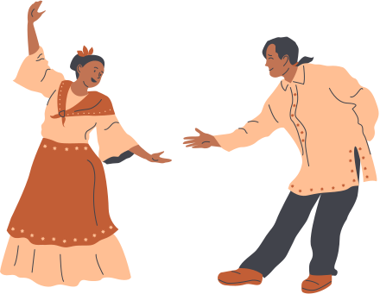
Comic Dance
Comic Dances are those that depict funny movements for entertainment
Kinoton
Is a comic dance from Ilocos Sur. It depicts the movement of a person bitten by ants.
Makonggo
A comic dance which originated in Sta. Maria, Bulacan. A solo performer imitates the movements characteristic of a monkey, its gestures and grimaces.

Slide 32
Kinoton

Slide 33
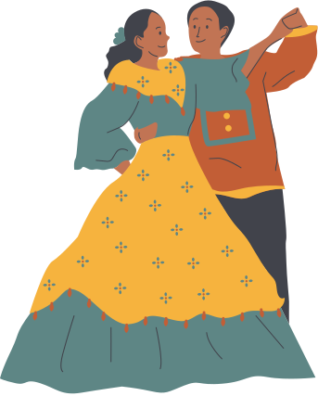
Game Dance
Game Dances are those that are done with play elements.
Lubi-Lubi
Lubi-Lubi is a bicolano dance which is a combination of a simple folk and social steps. Literally, lubi means coconut. According to the BIkolanos this dance originated in Leyte and Samar where it is still danced like the Balitaw. It is also popular in Albay and Sorsogon.

Slide 34
Lubi-Lubi

Slide 35
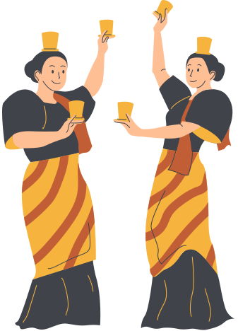
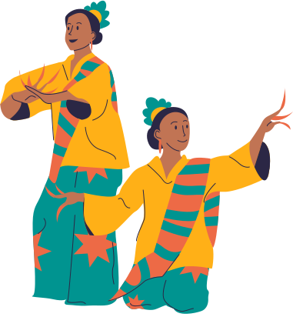
Wedding Dance
Wedding Dances are those dances that are performed during wedding feasts.
Pagkawin
The wedding ceremony is called Pagkawin. The festivity opens with the Pahanda or presentation of dowry. Relatives of the groom present to the relatives of the bride traditional dowries that usually include that Salap-pa, A bras box containing money, jewelry, other valuables, and all important betel nut.

Slide 36
Pagkawin

Slide 37
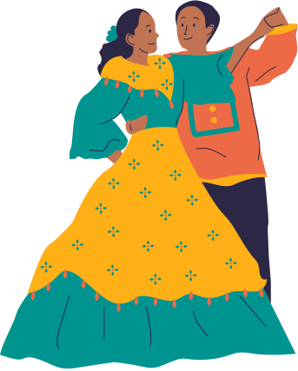
Courtship Dance
Sua-ku-sua
A courtship dance is a ceremonial dance in which the male pursues a female who may
accept or reject the male's attention. Courtship dances are usually per- formed during
special occasions
This is a dance from Jolo, Sulu. Literally, “Sua-ku-sua” means “my pomelo tree”. According to the Moros of the older generation, the movements in this dance have been modified and modernized. Dancers sing as they perform the dance. The natives often repeat the dance as many times as they like or until they are made to stop.

Slide 38
Sua-ku-sua

Slide 39
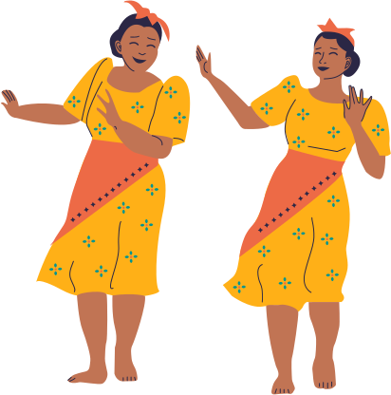
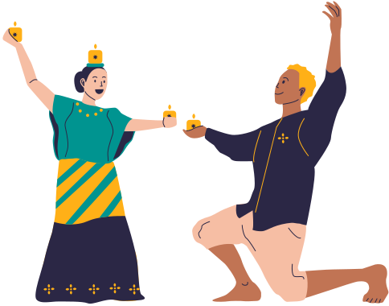
Festival Dance
Festival dances are cultural dances performed to the strong beats of percussion instruments by a community of people sharing the same culture. festival dances. example is the honor of a Patron Saint or in thanksgiving of a bountiful harvest
Pandanggo
Pandangggo sa Ilaw or “Fandango” is a very popular folk dance in the Philippines. It is said to have originated from Mindoro, This dance of lights simulates fireflies at dusk and at night. The phrase “sa ilaw” is Tagalog for “in light” and it refers to the three oil lamps that are dances has to balance. The oil lamp is called tinghoy.

Slide 40
Pandanggo

Slide 41
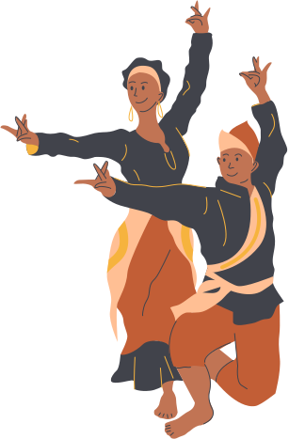
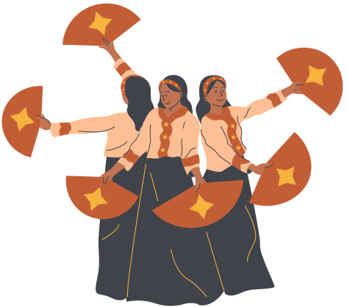
War Dance
A war dance is a dance involving mock combat, usually in reference to tribal warrior
societies where such dances were performed as a ritual connected with endemic
warfare.
Sagayan
A philippine war dance performed by both the Maguindanao and Maranao depicting in dramatic fashion the steps their hero, Prince Bantugan, took upon wearing his armaments, the war he fought in, and his subsequent victory afterwards.

Slide 42
Sagayan

